Slide 1
Credit Card Fraud detection & prevention thru Machine Learning
Mar 21
Vijayalakshmi : 2314
Sameer : 12831
Sridhar : 43953
Sakthivel :23201
Muthukumar : 3160
Kesar : 4817

Slide 2
Objective
Credit card fraud is when anonymous person uses another person's credit card or account information to make unauthorized transactions such us purchases, e-commerce transactions , cash advances etc.
Fraud is a major problem for the whole credit card industry that grows bigger with the increasing popularity, demand and ease to do electronic money transfers.
Fraud detection is a set of activities that are taken to prevent money from being obtained through false pretenses such as leakage of bank account information leak, card skimming, counterfeit credit cards, clone transactions etc.

Slide 3
Background
Credit card fraud is usually caused either by card owner’s negligence with his data or by a breach in a website’s security like listed below
Customer revealing card information to unknown person
Card is stolen and lost which someone misuses
Making counterfeit credit card and Swipe machine fraud
Ignorance on Security warnings and linking card for unauthorized transactions
Credit card fraud results in the
loss of reputation and customer loyalty
Create negative impact on the business and affects the revenue and turnover of the company
Fraudulent methods are getting more sophisticated and thus harder to spot by traditional fraud detection method. Also, it takes enormous time, manpower, lengthy validation process and only detect obvious fraud activities

Slide 4
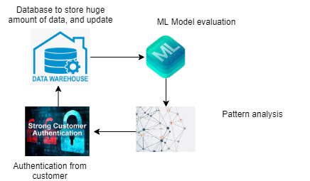
Proposal
Credit Card Fraud detection with machine learning is a process of consolidating card users transaction data such as Timestamp, User Zone, Amount, Geolocation, device identification, historic transaction patterns, and the actual transaction information etc.,
Developing a trained model using the consolidated information that finds patterns and rules so that it can classify whether a transaction is fraudulent or is legitimate. Preventing the fraud by calling the impacted customers through CALLBOT in real-time.

Slide 5

Architecture

Slide 6
Benefits
It is need of the hour to implement Advanced and Pro-Active Credit Card Fraud Prevention and Fraud Detection methods thru Machine learning by
Higher accuracy of Fraud detection
Automatic detection of possible fraud scenarios
Real-time processing
Reduced number of verification measures
Identifying new patterns and adapt to changes
Machine Learning-based methods can continuously improve the accuracy of fraud prevention based on information about each cardholder’s behavior.

Slide 7

Thank you

